Slide 1
Bayesian Networks (Chapters 12&13)
Dr. Shengquan Wang
Most slides are adopted from
Artificial Intelligence: A Modern Approach, 4th ed. by Stuart Russell (UC Berkeley) and Peter Norvig (Google).
Peter Norvig and Sebastian Thrun for Intro to Artificial Intelligence at Udacity.

Slide 2

Example: Maze under Windy Situation
f
e
0.8
↑
0.1
0.1
d
c
0.1
b
↑
0.8
0.1
a
1
2
3
4
5
6
Notes:
Run 4 examples

Slide 3
Example: Car Diagnosis
battery age
alternator broken
fanbelt broken
battery dead
not charging
battery meter
battery flat
no oil
no gas
fuel line blocked
starter broken
lights
oil light
gas gauge
car won’t start
dipstick
link: uncertain/probabilistic

Slide 4
Example: Probabilistic Propositional Logic
Burglary
Earthquake
Alarm
MaryCalls
JohnCalls

Slide 5
Outline
Uncertainty

Slide 6
Example: Coin Flips
Coin flip | h | t | t, h | t, t, t
Probability | 0.5
0.5
0.5*0.5=0.25
0.5*0.5*0.5=0.125
Coin flip | h | t | t, h | t, t, h
Probability | 0.4
0.6
0.6*0.4=0.24
0.6*0.6*0.4=0.144

Slide 7
Properties of Probabilities
Random Variables X and Y
Complementary probability:
P(¬x) = 1 - P(x)
Independence:
X ⊥ Y: P(x, y) = P(x) P(y)
Notation:
P(x) ≡ P(X=x)
P(¬x) ≡ P(X=¬x)
P(y) ≡ P(Y=y)
P(x,y) ≡ P(X=x, Y=y)

Slide 8
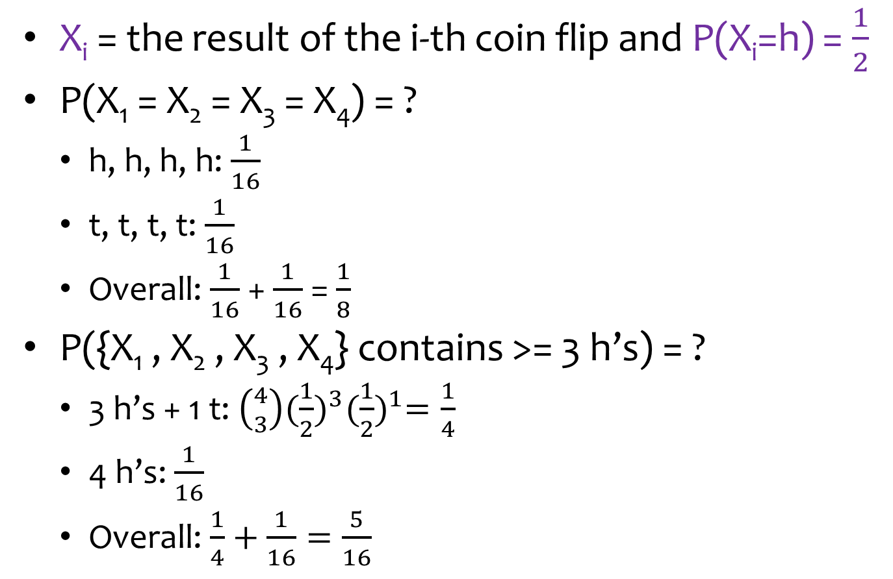
Example: Coin Flips (cont’d)
X_{i} = the result of the i-th coin flip and P(X_{i}=h) = $\frac{1}{2}$
P(X₁ = X₂ = X₃ = X₄) = ?
h, h, h, h: $\frac{1}{16}$
t, t, t, t: $\frac{1}{16}$
Overall: $\frac{1}{16}$ + $\frac{1}{16}$ = $\frac{1}{8}$
P({X₁ , X₂ , X₃ , X₄} contains >= 3 h’s) = ?
3 h’s + 1 t: $\left({4 \atop 3}\right){(\frac{1}{2})}^{3}{(\frac{1}{2})}^{1}=\frac{1}{4}$
4 h’s: $\frac{1}{16}$
Overall: $\frac{1}{4}+\frac{1}{16}=\frac{5}{16}$

Slide 9

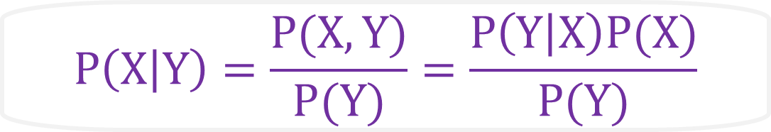
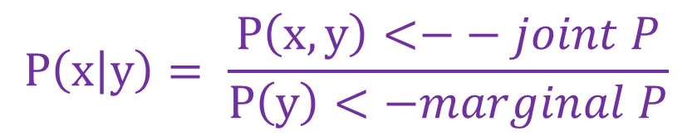
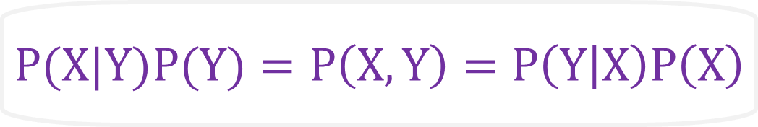

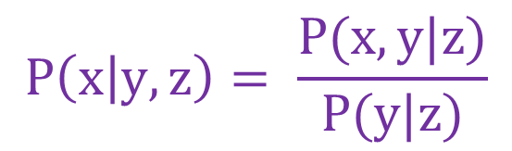
Conditional (transitional) Probabilities
Notation:
P(x|y) ≡ P(X=x|Y=y)
$$P\left(x | y\right)= \frac{P\left(x,y\right)<−− joint P}{P\left(y\right)<−marginal P}$$
$$P\left(x,y\right)=P\left(x | y\right)P\left(y\right)$$
$$P\left(x | y,z\right)= \frac{P(x,y|z)}{P(y|z)}$$
$$P(x,y|z) =P(x|y,z)P(y|z)$$
$$P(X|Y)P(Y)=P\left(X,Y\right)=P\left(Y | X\right)P\left(X\right)$$
Bayes’ Rule:
likelihood
prior
posterior
$$P\left(X | Y\right)=\frac{P(X,Y)}{P(Y)}=\frac{P\left(Y | X\right)P(X)}{P(Y)}$$
marginal likelihood

Slide 10
Example on Conditional Probabilities
https://en.wikipedia.org/wiki/Conditional_probability
The probability that any given person has a cough on any given day may be only 5%:
P(Cough) = 5%
But if we know or assume that the person has a cold, then they are much more likely to be coughing.
The conditional probability that someone coughing has a cold might be 75%:
P(Cold | Cough) = 75%
Notes:
*if someone is coughing and it is not know that they have a cold, it is much more difficult to predict they have a cold because the probabilities is spread out over so many scenarios that will result in a person coughing (the distribution of P is over many variables).

Slide 11
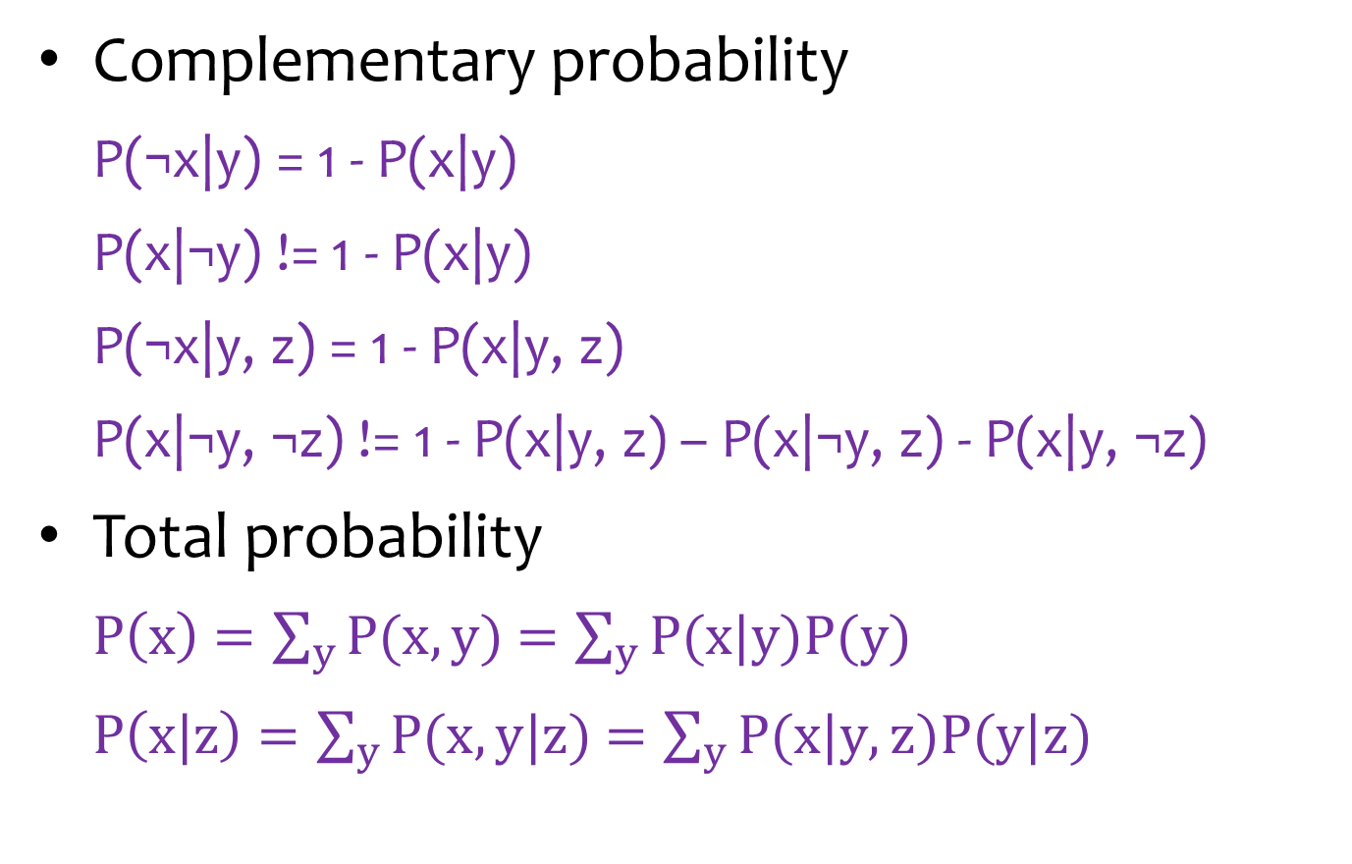
Properties of Conditional Probabilities
Complementary probability
P(¬x|y) = 1 - P(x|y)
P(x|¬y) != 1 - P(x|y)
P(¬x|y, z) = 1 - P(x|y, z)
P(x|¬y, ¬z) != 1 - P(x|y, z) – P(x|¬y, z) - P(x|y, ¬z)
Total probability
$P\left(x\right)$ $=\sum_{y}{P(x,y)}$ $=\sum_{y}{P(x|y)P(y)}$
$P\left(x|z\right)$ $=\sum_{y}{P(x,y|z)}$ $=\sum_{y}{P(x|y,z)P(y|z)}$
Notes:
X and Y could be binary (binary, discrete random variable) variables, or variables that can take many values (more than 2 possible inputs for the variable).

Slide 12
Example: Coin Flips (cont’d)
We have two coin flips, but the 2nd conditionally depends on the result of the 1st.
1st coin flip:
P(X₁=h) = 0.5
2nd coin flip:
P(X₂=h|X₁=h) = 0.9; P(X₂=t|X₁=t) = 0.8
P(X₂=h) = ?
= P(X₂=h|X₁=h) * P(X₁=h) + P(X₂=h|X₁=t) * P(X₁=t)
= 0.9 * 0.5 + (1 - 0.8) * (1 - 0.5) = 0.55
(notice complementary feature used)

Slide 13

Quiz: Weather
Weather on two days: sunny or rainy
P(D₁=s) = 0.9
P(D₂=s | D₁=s) = 0.8
P(D₂=s | D₁=r) = 0.6
P(D₂=s) = ?
= 0.9 * 0.8 + 0.1 * 0.6 = 0.78
P(D₃=s) = ?
= 0.78 * 0.8 + 0.22 * 0.6 = 0.756
Notes:
*we assume Probs are stationary (i.e. P D3 = sunny given D1=sunny is still = 80%).
*eventually if you keep calculating, transitional probabilities will converge!

Slide 14
Outline
Uncertainty
Bayes’ Rule
Notes:
Bayes’ rule is uses evidence to update probabilities and make an inference.
Think about a detective: more evidence collected strengthens or weakens an inference.

Slide 15
Example: Librarian vs Farmer
https://www.youtube.com/watch?v=HZGCoVF3YvM
Steve was selected at random from a representative sample, who has been described by a neighbor as follows:
“Steve is very shy and withdrawn, invariably helpful but with little interest in people or in the world of reality. A meek and tidy soul, he has a need for order and structure, and a passion for detail.”
Is Steve more likely to be a librarian or a farmer?
Most people assume Steve is a librarian.
Actually, Steve is more likely a farmer.

Slide 16
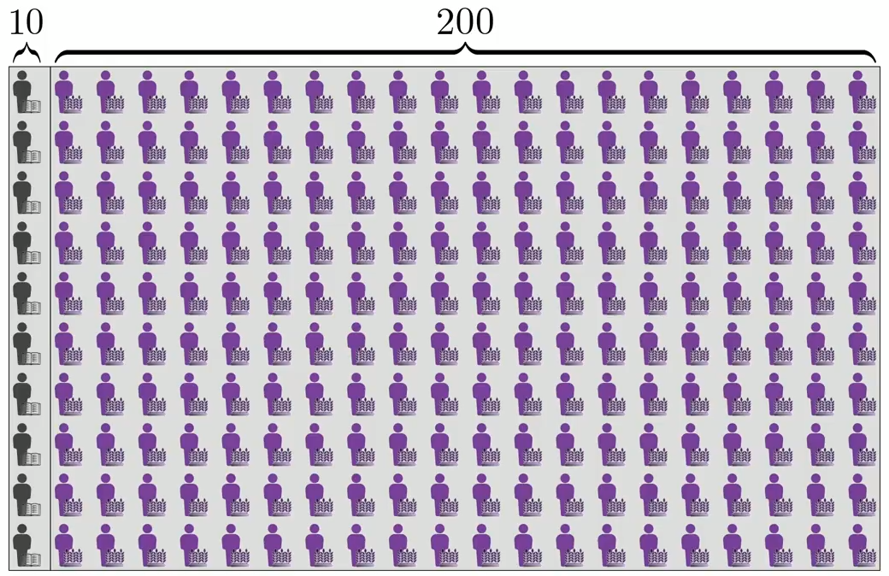
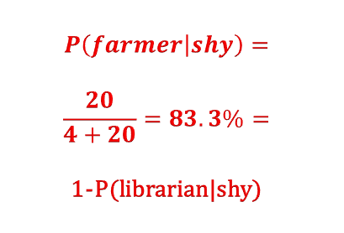
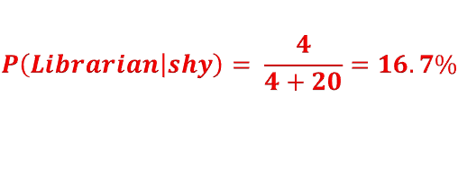
Example: Librarian vs Farmer (cont’d)
$$P\left(Librarian | shy\right)= \frac{4}{4+20}=16.7\%$$
$$P\left(farmer | shy\right)=$$
$$\frac{20}{4+20}=83.3\%=$$
1-P(librarian|shy)
40%
10%

Slide 17
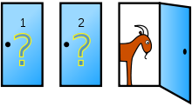

Example: Monty Hall Problem
Suppose you're on a game show, and you're given the choice of three doors:
Behind one door is a car;
behind the others, goats.
You pick a door, say No. 1, and the host, who knows what's behind the doors, opens another door, say No. 3, which has a goat.
He then says to you, "Do you want to pick door No. 2?"
Is it to your advantage to switch your choice?
3
https://en.wikipedia.org/wiki/Monty_Hall_problem
Notes:
Yes. It is to your advantage, because the game host does not randomly select; he purposely selects a door to open that will not have the car behind it.

Slide 18
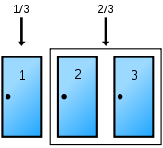
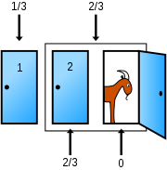
Example: Monty Hall Problem (cont’d)
Notes:
Notice, when host selects a door to open, he has to choose between two out of the three total doors (2/3 → the chance that the car is behind the 2 doors that the host is left to select from); the fact that when he will choose between 2/3 doors he will definitely not select the one with the car (provided you did not select the car door, i.e. the car is behind one of the doors that he is left to choose from = 2/3 doors = 2/3 chance the car is behind one of those doors), is the reason why when he does select a door to open (and we can guarantee it will not be the car), then that 2/3 probability shifts (is redistributed) to that one remaining door, i.e., there is 1/3 chance the car is behind the players door, and 2/3 chance that it is behind the 1 remaining door, and obviously a 0/3 chance it is behind the door that the host opens/will open. Key is: the hosts actions are not random, THUS: when he open a door, he is actually giving the player some evidence, which can be used to update/infer the new probability distribution for which door the car is behind → BAYES THEOREM.

Slide 19
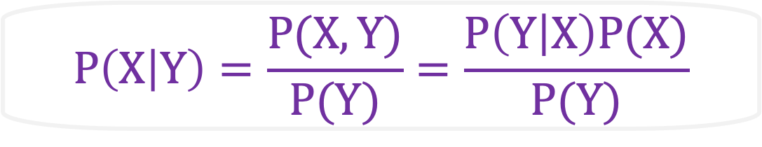
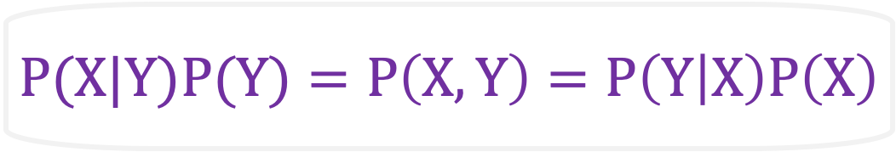
Summary: Bayes’ Rule
$$P(X|Y)P(Y)=P\left(X,Y\right)=P\left(Y | X\right)P\left(X\right)$$
likelihood
prior
posterior
$$P\left(X | Y\right)=\frac{P(X,Y)}{P(Y)}=\frac{P\left(Y | X\right)P(X)}{P(Y)}$$
marginal likelihood

Slide 20
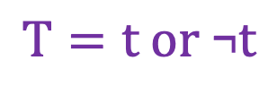
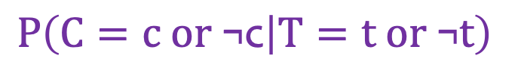
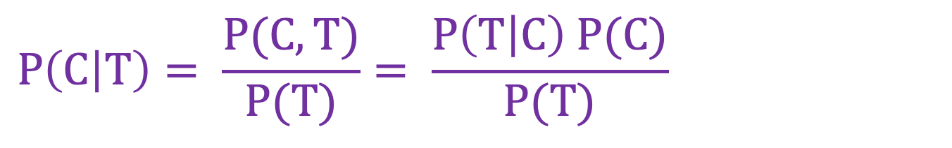
Diagnostic Reasoning
Cancer
hidden
Cancer: c (yes); ¬c (no)
$$P\left(C=c or \text{¬}\text{c} | T=t \text{or} \text{¬}t\right)$$
$$T=t \text{or} \text{¬}t$$
Test
evident
Test: t (positive); ¬t (negative)
$$P\left(C | T\right)= \frac{P(C,T)}{P(T)}= \frac{P\left(T | C\right) P(C)}{P(T)}$$

Slide 21
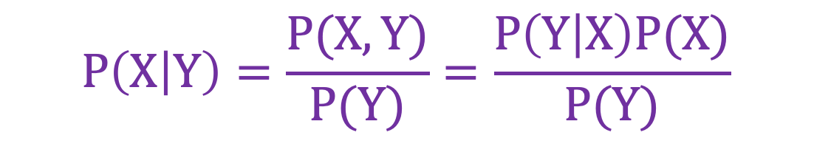
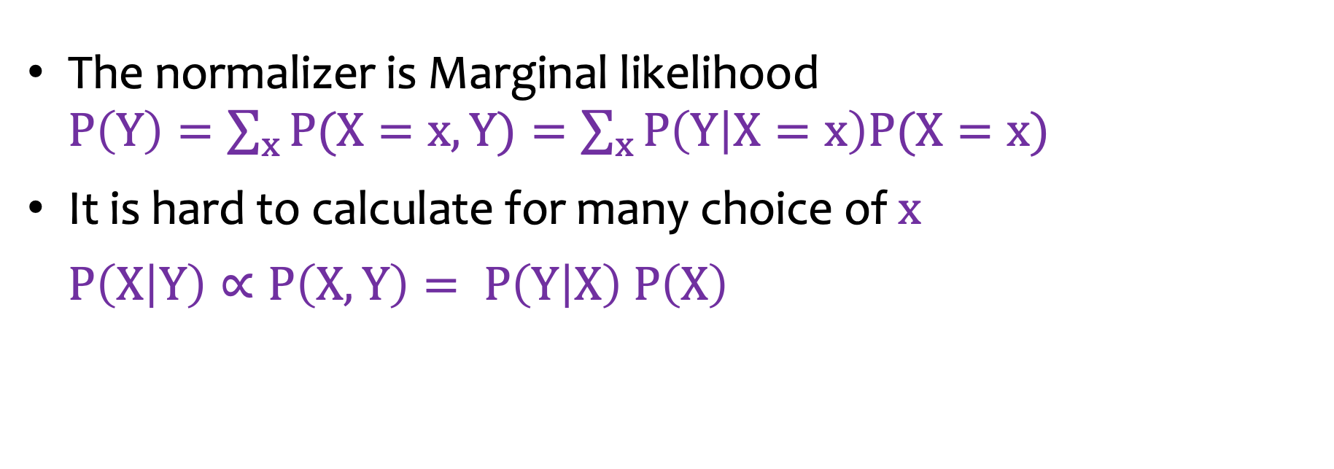
Bayes’ Rule: Normalizer
$$P\left(X | Y\right)=\frac{P(X,Y)}{P(Y)}=\frac{P\left(Y | X\right)P(X)}{P(Y)}$$
The normalizer is Marginal likelihood $P\left(Y\right)=\sum_{x}{P(X=x,Y)}=\sum_{x}{P\left(Y | X=x\right)P(X=x)}$
It is hard to calculate for many choice of $x$
$P\left(X | Y\right)∝P\left(X,Y\right)= P\left(Y | X\right) P\left(X\right)$

Slide 22
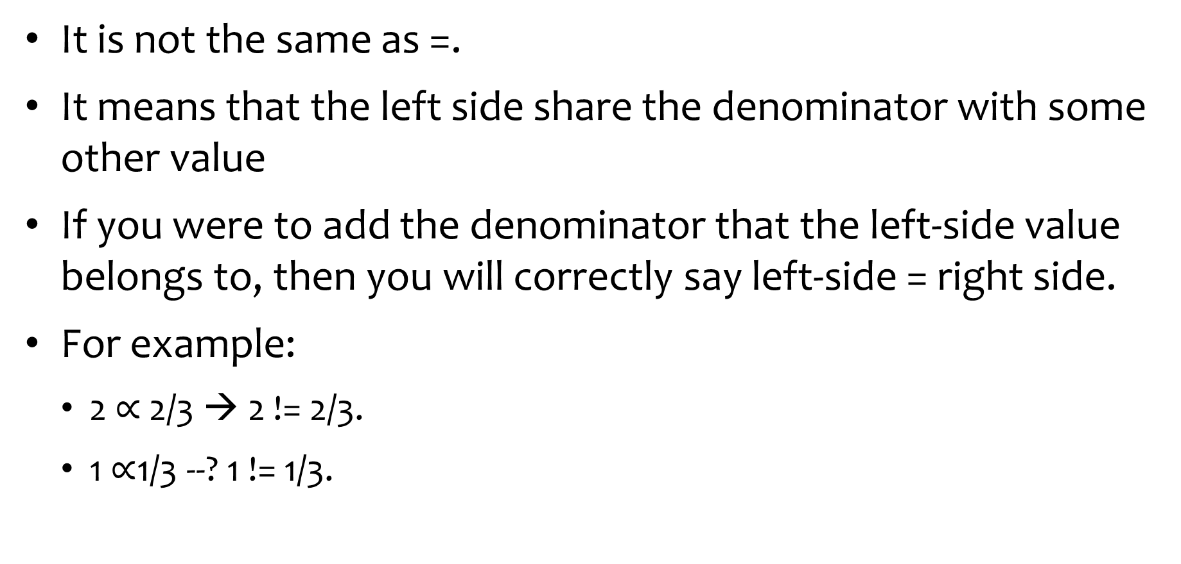
Special note on $∝$ (proportional symbol)
It is not the same as =.
It means that the left side share the denominator with some other value
If you were to add the denominator that the left-side value belongs to, then you will correctly say left-side = right side.
For example:
2 $∝$ 2/3 → 2 != 2/3.
1 $∝$1/3 --? 1 != 1/3.

Slide 23
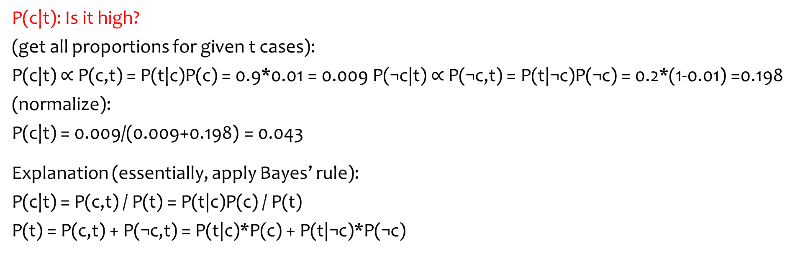
Example: 1-Test Cancer
P(c) = 0.01→P(¬c) = 0.1
P(t|c) = 0.9 →P(¬t|c) = 0.1
P(t|¬c) = 0.2 →P(¬t|¬c) = 0.7
C
T
P(c|t): Is it high?
(get all proportions for given t cases):
P(c|t) $∝$ P(c,t) = P(t|c)P(c) = 0.9*0.01 = 0.009 P(¬c|t) $∝$ P(¬c,t) = P(t|¬c)P(¬c) = 0.2*(1-0.01) =0.198
(normalize):
P(c|t) = 0.009/(0.009+0.198) = 0.043
Explanation (essentially, apply Bayes’ rule):
P(c|t) = P(c,t) / P(t) = P(t|c)P(c) / P(t)
P(t) = P(c,t) + P(¬c,t) = P(t|c)*P(c) + P(t|¬c)*P(¬c)
Notes:
Notice which term in the denominator when normalizing (thus completing BAYE’S RULE) is the largest (0.198).

Slide 24
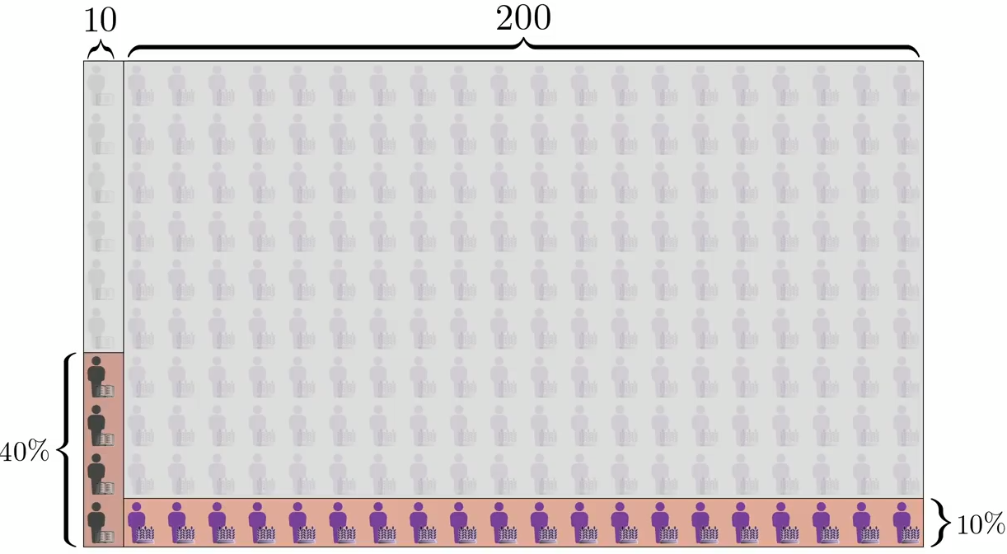
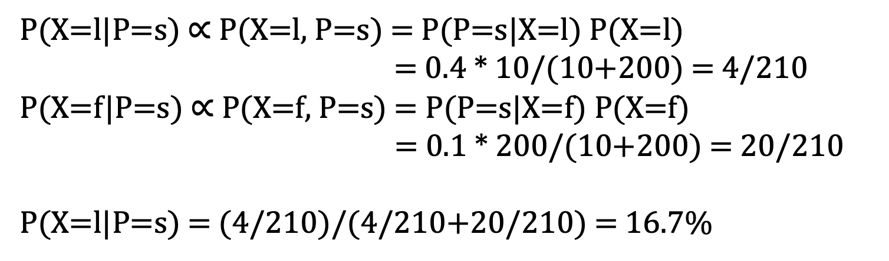
Applying Bayes’ Rule in Librarian vs Farmer
X: l - librarian; f - farmer
P: s - very shy and withdrawn; o - outgoing
P(X=l|P=s) $∝$ P(X=l, P=s) = P(P=s|X=l) P(X=l)
= 0.4 * 10/(10+200) = 4/210
P(X=f|P=s) $∝$ P(X=f, P=s) = P(P=s|X=f) P(X=f)
= 0.1 * 200/(10+200) = 20/210
P(X=l|P=s) = (4/210)/(4/210+20/210) = 16.7%

Slide 25

Applying Bayes’ Rule in Monty Hall Problem
C: the door that the car is behind
O: the door that is opened
Notice you need to calculate all proportions for P(C) scenarios given O=3, then normalize:
P(C=1|O=3) $∝$ P(C=1, O=3) = P(O=3|C=1)P(C=1)
= 1/2 * 1/3 = 1/6
P(C=2|O=3) $∝$ P(C=2, O=3) = P(O=3|C=2)P(C=2)
= 1 * 1/3 = 1/3
P(C=3|O=3) $∝$ P(C=3, O=3) = P(O=3|C=3)P(C=3)
= 0 * 1/3 = 0 (host will never open door with car behind it)
Normalize:
P(C=2|O=3) = (1/3)/(1/6+1/3+0) = 2/3

Slide 26
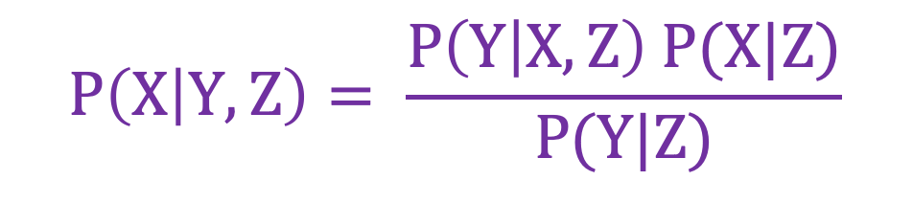
Bayes’ Rule: More Conditional Variables
$$P\left(X | Y,Z\right)= \frac{P\left(Y | X,Z\right) P(X|Z)}{P(Y|Z)}$$

Slide 27
Outline
Uncertainty
Bayes’ Rule
Bayesian Networks

Slide 28
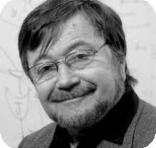
Judea Pearl: Turing Award (2011)
https://amturing.acm.org/award_winners/pearl_2658896.cfm
Notes:
He does not like classical probability that most school teach: he came up with theory about actual cause and effect between two variables and essentially invented what is known today as Bayesian Networks.

Slide 29
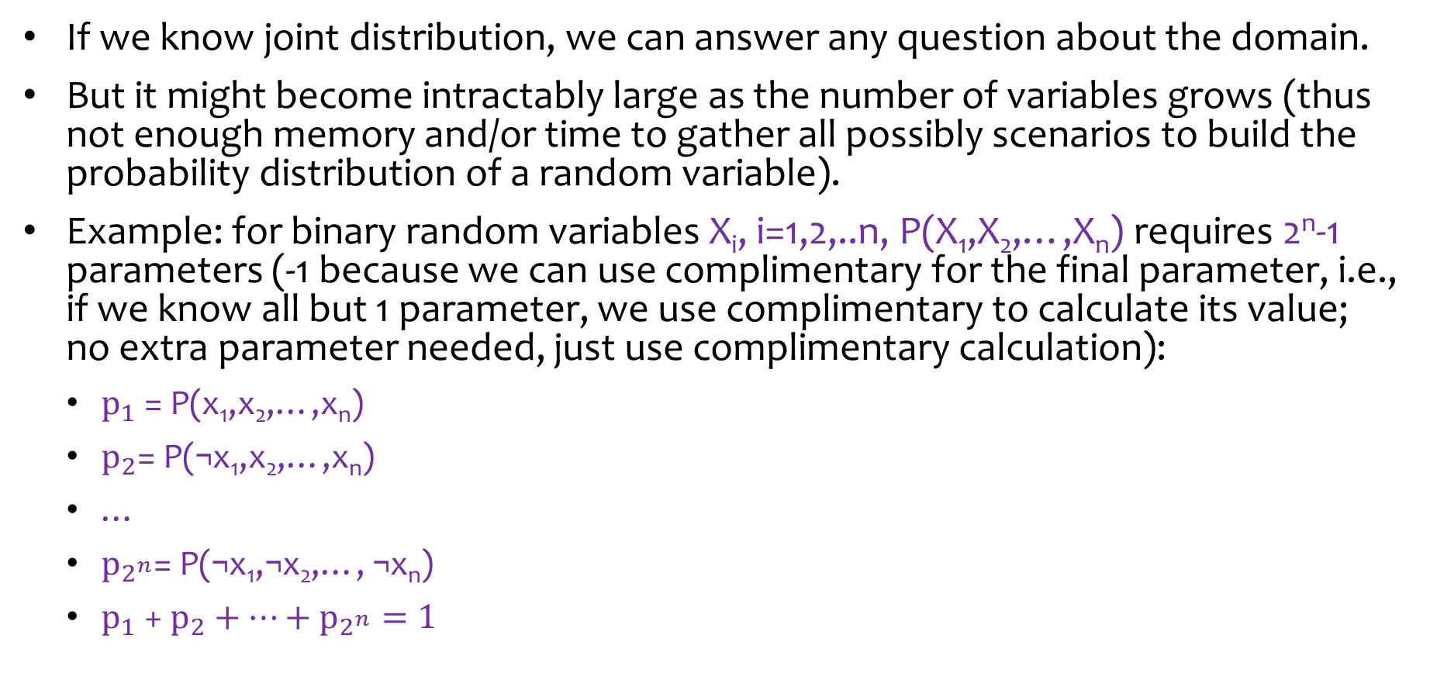
Intractability of Joint Distribution
If we know joint distribution, we can answer any question about the domain.
But it might become intractably large as the number of variables grows (thus not enough memory and/or time to gather all possibly scenarios to build the probability distribution of a random variable).
Example: for binary random variables X_{i}, i=1,2,..n, P(X₁,X₂,…,X_{n}) requires 2^{n}-1 parameters (-1 because we can use complimentary for the final parameter, i.e., if we know all but 1 parameter, we use complimentary to calculate its value; no extra parameter needed, just use complimentary calculation):
$p_{1}$ = P(x₁,x₂,…,x_{n})
$p_{2}$= P(¬x₁,x₂,…,x_{n})
…
$p_{2^{n}}$= P(¬x₁,¬x₂,…, ¬x_{n})
$p_{1}$ + $p_{2}+…+p_{2^{n}}=1$
Notes:
Pearl was able to reduce the number of parameters for Joint Distribution, thereby transforming many previously intractable joint distributions into a now tractable distribution.

Slide 30
Bayesian Networks (reduce amount of time and space required to calculate joint probability distributions)
A Bayesian network is a data structure to represent the dependencies/independencies among variables.
Using independence can reduce the number of parameters for joint distribution.
X
Y
Z
Y
Z
X
P(X,Y,Z) =
P(X) P(Y|X) P(Z|X)
P(X,Y,Z) =
P(Y) P(Z) P(X|Y,Z)

Slide 31
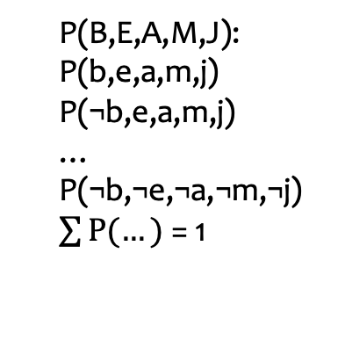
Complex Bayesian Networks
Burglary
Earthquake
B,E,A,M,J: binary discrete variables
Node probability depends on the arcs (notice the arc direction): P(B), P(E), P(A|B,E), P(M|A), P(J|A)
Alarm
MaryCalls
JohnCalls
P(B,E,A,M,J) = P(B) P(E) P(A|B,E) P(M|A) P(J|A)
P(B,E,A,M,J):
P(b,e,a,m,j)
P(¬b,e,a,m,j)
…
P(¬b,¬e,¬a,¬m,¬j)
$\sum{P(…)}$ = 1
P(B):
P(b); P(¬b)=1-P(b)
P(M|A):
P(m|a); P(¬m|a)=1-P(m|a)
P(m|¬a); P(¬m|¬a)=1-P(m|¬a)
1 parameter for each P(B) and P(E)
2 parameters each for P(M|A) and P(J|A)
P(A|B,E):
P(a|b,e); P(¬a|b,e)=1-P(a|b,e)
P(a|¬b,e); P(¬a|¬b,e)=1-P(a|¬b,e)
P(a|b,¬e); P(¬a|b,¬e)=1-P(a|b,¬e)
P(a|¬b,¬e); P(¬a|¬b,¬e)=1-P(a|¬b,¬e)
2⁵-1 = 31 parameters
4 parameters
Notes:
For binary discrete variables where you are looking for P(B), you only need 1 parameter because if you know 1 parameter, you can use complimentary to find the other (i.e. P(!B) = 1-P(B)). So, you can save memory.
Notice for P(A|B,E) → need 2^2 – 1 because we already know P(E), and for final parameter we can solve by complimentary.
Notice above, without Bayesian network, you need 32 parameters; but with Bayesian network, you can save a lot of memory because you only need a total of 7 parameters in order to figure out all other parameters and use Bayes Theorem.

Slide 32
Complex Bayesian Networks
Burglary
Earthquake
B,E,A,M,J: binary discrete variables
Node probability depends on the arcs: P(B), P(E), P(A|B,E), P(M|A), P(J|A)
Alarm
MaryCalls
JohnCalls
P(B,E,A,M,J) = P(B) P(E) P(A|B,E) P(M|A) P(J|A)
# of probability parameters
2⁵ - 1
1
+
1
+
4
+
2
+
2
= 31
= 10
Compact!

Slide 33
Quiz
A
B
C
A,B,C,D,E,F,G: binary discrete variables
P(A,B,C,D,E,F,G) = ?
# of probability parameters = ?
D
E
F
G
P(A,B,C,D,E,F,G) = P(A) P(B) P(C) P(D|A,B,C) P(E|D) P(F|D) P(G|C,D)
2⁷ - 1
1
+
1
+
1
+
8
+
2
+
2
+
4
= 127
= 19
Notes:
P(A) → 1 parameter needed (!A parameter calculated via complimentary)
P(B) → 1 parameter needed (!B parameter calculated via complimentary)
P(C) →1 parameter needed (!C parameter calculated via complimentary)
P(D|A,B,C) → 8 parameters needed (!D|A,B,C calculated via complimentary; for A B and C, each are discrete → 2^3 = 8 scenarios)
P(E|D) → 2 parameters (!E|D calculated via complimentary; D is binary = 2 scenarios)
P(F|D) →2 parameters (!F|D calculated via complimentary; D is binary = 2 scenarios)
P(G|C,D)→ 4 parameters (!G|C,D calculated via complimentary; C and D are binary = 2^2 = 4 scenarios)

Slide 34
Quiz: Car Diagnosis
All: binary variables
Without Bayesian Network model: 2¹⁶-1 = 65535 probability parameters
1
1
1
battery age
alternator broken
fanbelt broken
battery dead
2
not charging
4
1
1
1
1
2
battery meter
battery flat
4
no oil
no gas
fuel line blocked
starter broken
2
lights
4
oil light
4
gas gauge
32
car won’t start
dipstick
2
With Bayesian Network model: 63

Slide 35


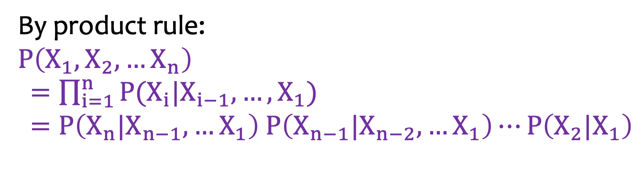



Constructing a General Bayesian Network
By product rule:
$$P\left(X_{1},X_{2},…X_{n}\right)$$
$=\prod_{i=1}^{n}{P(X_{i}|X_{i−1},…,X_{1})}$ $=P\left(X_{n}|X_{n−1},…X_{1}\right) P\left(X_{n−1}|X_{n−2},…X_{1}\right)⋯P\left(X_{2}|X_{1}\right)$
$$X_{1}$$
$$X_{2}$$
$$X_{5}$$
$$X_{3}$$
$$X_{4}$$

Slide 36





Quiz: a General Bayesian Network
By product rule:
$$P\left(X_{1},X_{2},…X_{n}\right)$$
$=\prod_{i=1}^{n}{P(X_{i}|X_{i−1},…,X_{1})}$ $=P\left(X_{n}|X_{n−1},…X_{1}\right) P\left(X_{n−1}|X_{n−2},…X_{1}\right)⋯P\left(X_{2}|X_{1}\right)$
1
$$X_{1}$$
All: binary variables
2
$$X_{2}$$
$$X_{5}$$
16
$$X_{3}$$
$$X_{4}$$
4
8
1+2+4+8+16=2⁵-1 parameters

Slide 37
Bayesian Network for Independent Variables
$P\left(X_{1},X_{2},…X_{n}\right)$ $=P\left(X_{1}\right)P\left(X_{2}\right)⋯P\left(X_{n}\right)$
1
All: binary variables
$$X_{1}$$
1
$$X_{2}$$
$$X_{5}$$
1
$$X_{3}$$
$$X_{4}$$
1
1
5 parameters

Slide 38
Outline
Uncertainty
Bayes’ Rule
Bayesian Networks
D-Separation

Slide 39
D-Separation
evidence
A and B are d-separated iff every undirected path from A to B is “blocked”.
A path is “blocked” iff one or more of the following conditions is true:
There exists an evidence variable C on the path such that ->C->.
There exists an evidence variable C on the path such that <-C->.
There exists a variable C on the path such that neither it or any of its descendants is an evidence variable and ->C<-.
A
C
B
C
A
B
A
B
C
D
E

Slide 40
d-separation and Conditional Independence
if two variables are d-separated relative to a set of variables Z in a directed graph, then they are independent conditional on Z in all probability distributions such a graph can represent.

Slide 41
Example: d-separated
A
 | T/F
C⊥A
C⊥A|B
C⊥D
C⊥D|A
E⊥C|D
F
B
D
T
F
C
E
T
T

Slide 42
Quiz: d-separated
A
C
F
 | T/F
F⊥A
F⊥A|D
F⊥A|G
F⊥A|H
B
E
T
F
H
D
F
G
T

Slide 43
Quiz: d-separated
 | T/F
A⊥E
A⊥E|B
A⊥E|C
A⊥B
A⊥B|C
D⊥E|B
F⊥G
F⊥G|E
F
A
B
F
T
F
C
G
T
F
D
E
F
T
F
Notes:
for A⊥E|C, they are D separated because C is revealed, and thus A and E no longer have any dependence on each other.
D separation is all about dependency (I need to study this further).

Slide 44
Outline
Uncertainty
Bayes’ Rule
Bayesian Networks
D-Separation
Exact Inference

Slide 45
Example (notice the 3 categories: evidence, hidden, and query variables)
B
E
B,E,A,M,J:
binary random variables
M=m
Evidence variables
Hidden variables
Query variables
A
J, A, E
B=b
M
J
Mary calls to report the Alarm is ringing, and we want to know if there is a burglary.
The alarm might not be going off when Mary could be mistaken or lying.

Slide 46
Quiz
B
E
Evidence variables
Hidden variables
Query variables
J=j,
M=m
A
E, A
M
J
B=b
Both Mary and John call to report the Alarm is ringing, we want to know if there is a Burglary.

Slide 47
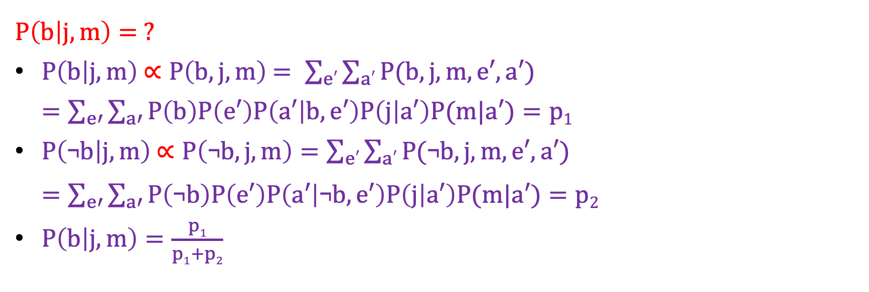
Inference by Enumeration (method to solve all parameters so we can use Bayes’ rule)
B
E
Evidence variables
Hidden variables
Query variables
J=j,
M=m
A
E, A
M
J
B=b
$P\left(b | j,m\right)= ?$
$P\left(b | j,m\right)$ $∝P\left(b, j, m\right)$ $= \sum_{e′}{\sum_{a′}{P(b,j,m,e′,a′)}}$
$=\sum_{e′}{\sum_{a′}{P\left(b\right)P\left(e′\right)P\left(a′ | b,e′\right)P\left(j | a′\right)P(m|a′)}}=p1$
$P\left(\text{¬}b | j,m\right)$ $∝P\left(\text{¬}b, j, m\right)=\sum_{e′}{\sum_{a′}{P(\text{¬}b,j,m,e′,a′)}}$
$=\sum_{e′}{\sum_{a′}{P\left(\text{¬}b\right)P\left(e′\right)P\left(a′ | \text{¬}b,e′\right)P\left(j | a′\right)P(m|a′)}}=p2$
$P\left(b | j,m\right)=\frac{p1}{p1+p2}$
Notes:
e’ in the equations above (and equivalencies of it like a’) refers to all possible values that the random variable E (or A) can take; need to consider all scenarios for the variable (i.e. a binary variable introduces 2 possible scenarios).
In this case, E and A are the only hidden variables: so now we see the benefit of Bayesian Network and the d-separation property: we can shorten/skip/reduce the number of Bayes rule parameters to only having to solve for the hidden variables and using the evidence variables in order to solve a query.

Slide 48
NOTES FROM CLASS GOING OVER HW2
KEY FOR BAYESIAN NETWORKS:
Evidence remains FIXED.
THEN: we find ALL COMBINATIONS for QUERY AND HIDDEN VARIABLES:
FOR EXAMPLE: A network (all variables are binary) with hidden variables A and B, Query is F=f, and evidence C=c
Then P(f|c), C remains FIXED as C=c; then we need to find all possible combinations for query F, and hidden variables A and B → thus we need 2^3 = 8 combinations to find joint probability of (A, B, F, and c), then use the different F=f and F=!f to find proportions of f given c, then we can normalize:
P(f|c) = P(f,A,B,c) / [P(f,A,B,c) + P(!f,A,B,c)]
Notes:
***Also remember with sensing we do filtering: we use proportion of the total probability (use Bayes rule); with motion we do prediction by using only total probability.
**for EXAMS: NO NOTES OR CHEAT SHEETS.

Slide 49
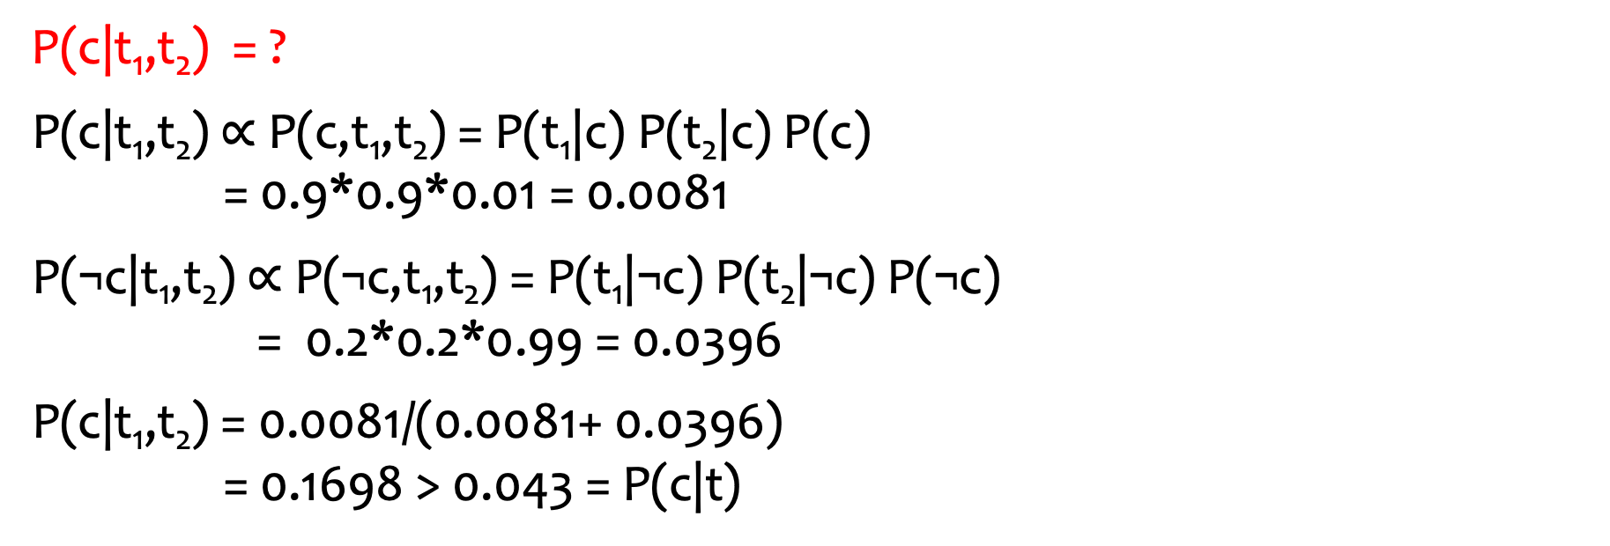
Example: 2-Test Cancer
C
P(c) = 0.01
P(t₁|c) = P(t₂|c) = 0.9
P(t₁|¬c) = P(t₂|¬c) = 0.2
T₁
T₂
P(c|t₁,t₂) = ?
P(c|t₁,t₂) $∝$ P(c,t₁,t₂) = P(t₁|c) P(t₂|c) P(c) = 0.9*0.9*0.01 = 0.0081
P(¬c|t₁,t₂) $∝$ P(¬c,t₁,t₂) = P(t₁|¬c) P(t₂|¬c) P(¬c) = 0.2*0.2*0.99 = 0.0396
P(c|t₁,t₂) = 0.0081/(0.0081+ 0.0396) = 0.1698 > 0.043 = P(c|t)

Slide 50

Example: 2-Test Cancer
C
P(c) = 0.01
P(t₁|c) = P(t₂|c) = 0.9
P(t₁|¬c) = P(t₂|¬c) = 0.2
T₁
T₂
P(t₁) = ?
= $\sum_{c′}{\sum_{t_{2}^{′}}{P(c^{′},t1{, t}_{2}^{′})}}$
= $\sum_{c′}{\sum_{t_{2}^{′}}{P({t1|c}^{′})P({t_{2}^{′}|c}^{′})P(c^{′})}}$
= $\sum_{c′}{P({t1|c}^{′})P(c^{′})}$
= P(t₁|c)P(c) + P(t₁|¬c)P(¬c)
= 0.9*0.01 + 0.2*0.99 = 0.207

Slide 51
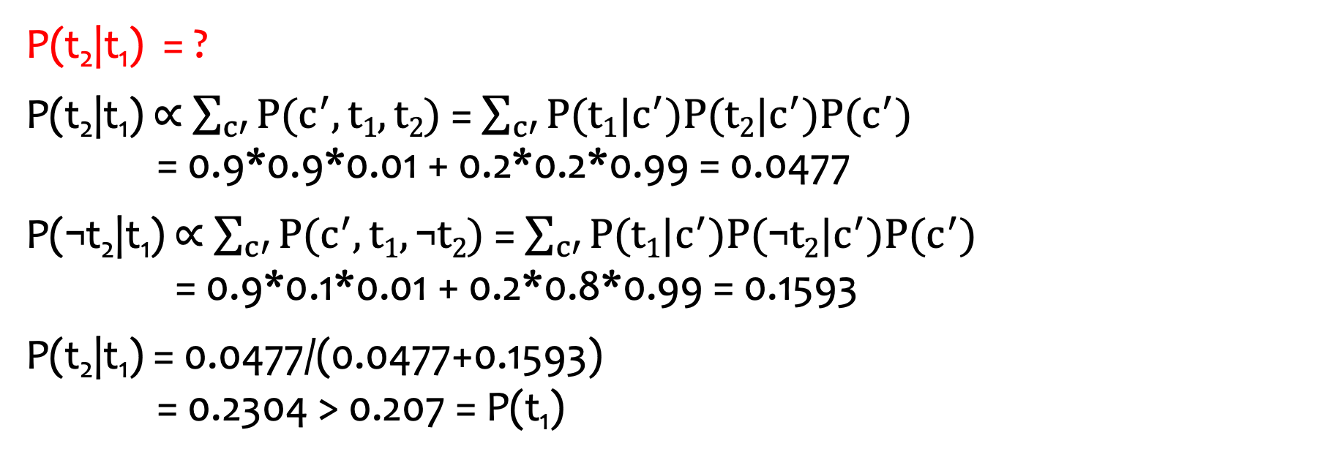
Example: 2-Test Cancer
C
P(c) = 0.01
P(t₁|c) = P(t₂|c) = 0.9
P(t₁|¬c) = P(t₂|¬c) = 0.2
T₁
T₂
P(t₂|t₁) = ?
P(t₂|t₁) $∝$ $\sum_{c′}{P(c^{′},t1,t2)}$= $\sum_{c′}{P({t1|c}^{′})P({t2|c}^{′})P(c^{′})}$ = 0.9*0.9*0.01 + 0.2*0.2*0.99 = 0.0477
P(¬t₂|t₁) $∝$ $\sum_{c′}{P(c^{′},t1,\text{¬}t2)}$= $\sum_{c′}{P({t1|c}^{′})P({\text{¬}t2|c}^{′})P(c^{′})}$ = 0.9*0.1*0.01 + 0.2*0.8*0.99 = 0.1593
P(t₂|t₁) = 0.0477/(0.0477+0.1593) = 0.2304 > 0.207 = P(t₁)
Notes:
NOTE: it makes sense that P(t2|t1) would be higher than P(t1), because if we have evidence t1 (positive test 1), then that means the chances that you have cancer is higher than 0.01, thus another test should increase the probability of having a positive test since now you are starting not from a 0.01 chance of cancer → but after the evidence t1 essentially chance>0.01 that you have cancer, as is the case as shown above: P(t2|t1) > P(t1).

Slide 52
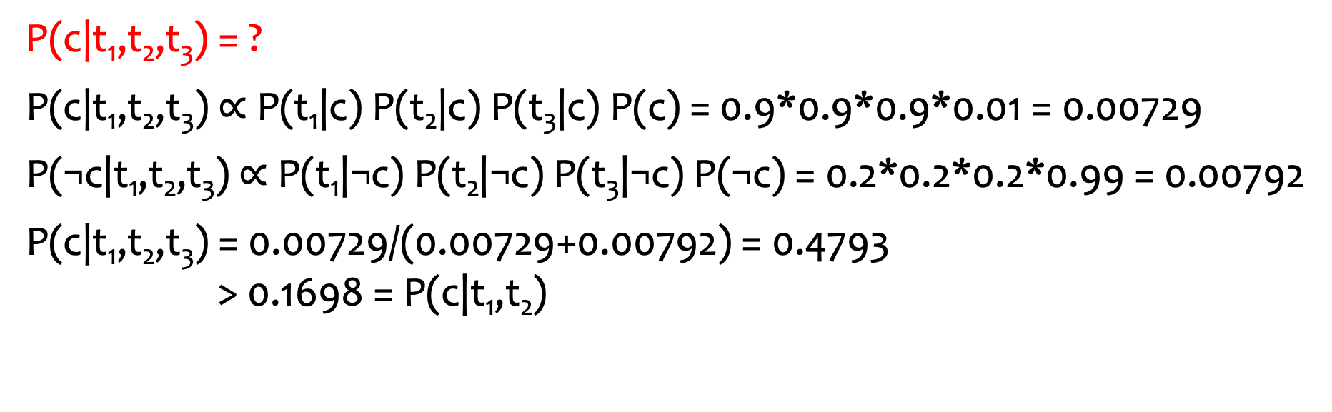
Quiz: 3-Test Cancer
C
P(c) = 0.01
P(t₁|c) = P(t₂|c) = P(t₃|c) = 0.9
P(t₁|¬c) = P(t₂|¬c) = P(t₃|¬c) = 0.2
T₁
T₂
T₃
P(c|t₁,t₂,t₃) = ?
P(c|t₁,t₂,t₃) $∝$ P(t₁|c) P(t₂|c) P(t₃|c) P(c) = 0.9*0.9*0.9*0.01 = 0.00729
P(¬c|t₁,t₂,t₃) $∝$ P(t₁|¬c) P(t₂|¬c) P(t₃|¬c) P(¬c) = 0.2*0.2*0.2*0.99 = 0.00792
P(c|t₁,t₂,t₃) = 0.00729/(0.00729+0.00792) = 0.4793 > 0.1698 = P(c|t₁,t₂)

Slide 53
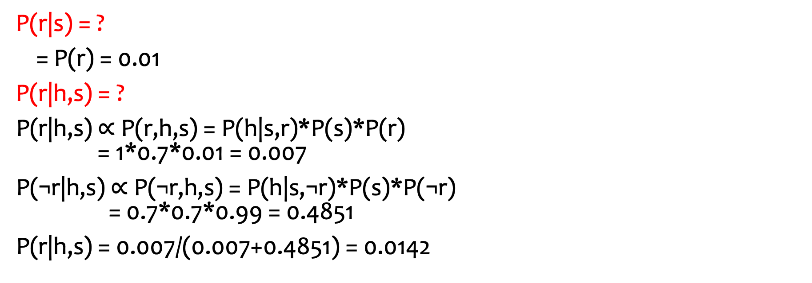
Confounding Causes
sunny day
salary raise
S
R
P(s) = 0.7 P(r) = 0.01
P(h|s,r) = 1 P(h|¬s,r) = 0.9
P(h|s,¬r) = 0.7 P(h|¬s,¬r) = 0.1
H
feeling happy
P(r|s) = ?
= P(r) = 0.01
P(r|h,s) = ?
P(r|h,s) $∝$ P(r,h,s) = P(h|s,r)*P(s)*P(r) = 1*0.7*0.01 = 0.007
P(¬r|h,s) $∝$ P(¬r,h,s) = P(h|s,¬r)*P(s)*P(¬r) = 0.7*0.7*0.99 = 0.4851
P(r|h,s) = 0.007/(0.007+0.4851) = 0.0142

Slide 54
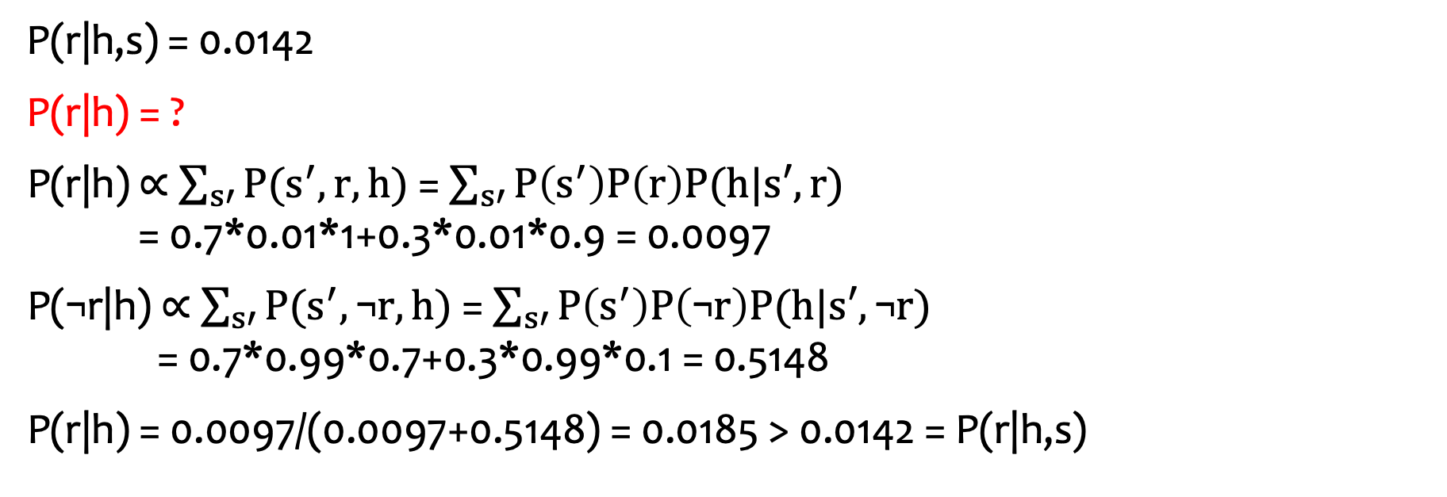
Confounding Causes
S
R
P(s) = 0.7 P(r) = 0.01
P(h|s,r) = 1 P(h|¬s,r) = 0.9
P(h|s,¬r) = 0.7 P(h|¬s,¬r) = 0.1
H
P(r|h,s) = 0.0142
P(r|h) = ?
P(r|h) $∝$ $\sum_{s′}{P(s^{′},r,h)}$= $\sum_{s′}{P\left(s^{′}\right)P\left(r\right)P(h|s′,r)}$ = 0.7*0.01*1+0.3*0.01*0.9 = 0.0097
P(¬r|h) $∝$ $\sum_{s′}{P(s^{′},\text{¬}r,h)}$= $\sum_{s′}{P\left(s^{′}\right)P\left(\text{¬}r\right)P(h|s′,\text{¬}r)}$ = 0.7*0.99*0.7+0.3*0.99*0.1 = 0.5148
P(r|h) = 0.0097/(0.0097+0.5148) = 0.0185 > 0.0142 = P(r|h,s)
Explaining away:
If I’m feeling happy and it is sunny, it is less likely that I’ve got salary raise.

Slide 55
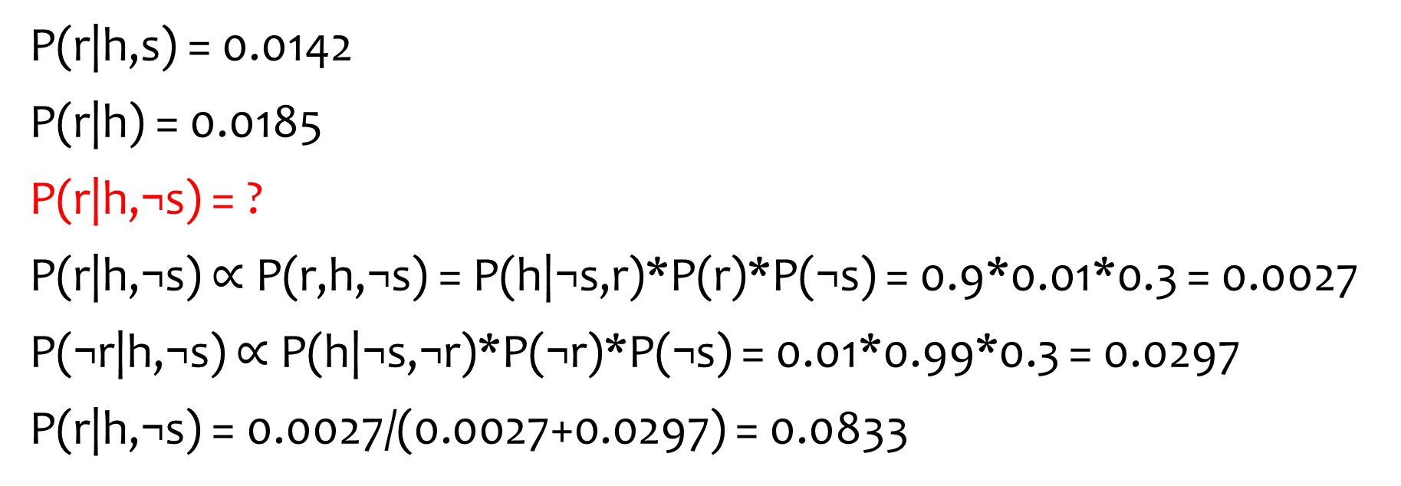
Confounding Causes
S
R
P(s) = 0.7 P(r) = 0.01
P(h|s,r) = 1 P(h|¬s,r) = 0.9
P(h|s,¬r) = 0.7 P(h|¬s,¬r) = 0.1
H
P(r|h,s) = 0.0142
P(r|h) = 0.0185
P(r|h,¬s) = ?
P(r|h,¬s) $∝$ P(r,h,¬s) = P(h|¬s,r)*P(r)*P(¬s) = 0.9*0.01*0.3 = 0.0027
P(¬r|h,¬s) $∝$P(h|¬s,¬r)*P(¬r)*P(¬s) = 0.01*0.99*0.3 = 0.0297
P(r|h,¬s) = 0.0027/(0.0027+0.0297) = 0.0833

Slide 56
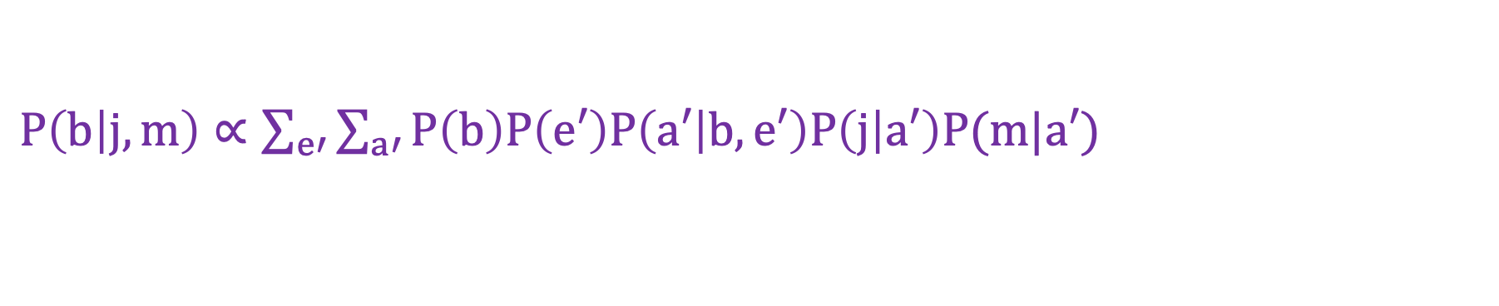
Complex Example
B | P(B)
b | 0.001
¬b | 0.999
E | P(B)
e | 0.002
¬e | 0.998
Joint probability distribution table
B
E
B | E | A | P(A|B,E)
b | e | a | 0.95
b | e | ¬a | 0.05
b | ¬e | a | 0.94
b | ¬e | ¬a | 0.06
¬b | e | a | 0.29
¬b | e | ¬a | 0.71
¬b | ¬e | a | 0.001
¬b | ¬e | ¬a | 0.999
A
M
J
A | M | P(M|A)
a | m | 0.7
a | ¬m | 0.3
¬a | m | 0.01
¬a | ¬m | 0.99
A | J | P(J|A)
a | j | 0.9
a | ¬j | 0.1
¬a | j | 0.05
¬a | ¬j | 0.95
$P\left(b | j,m\right)∝\sum_{e′}{\sum_{a′}{P\left(b\right)P\left(e′\right)P\left(a′ | b,e′\right)P\left(j | a′\right)P(m|a′)}}$
Notes:
Remember: the joint distributions in the table above comes from multiplication of all of the other nodes shown above (P(B), P(M|A), etc.)

Slide 57
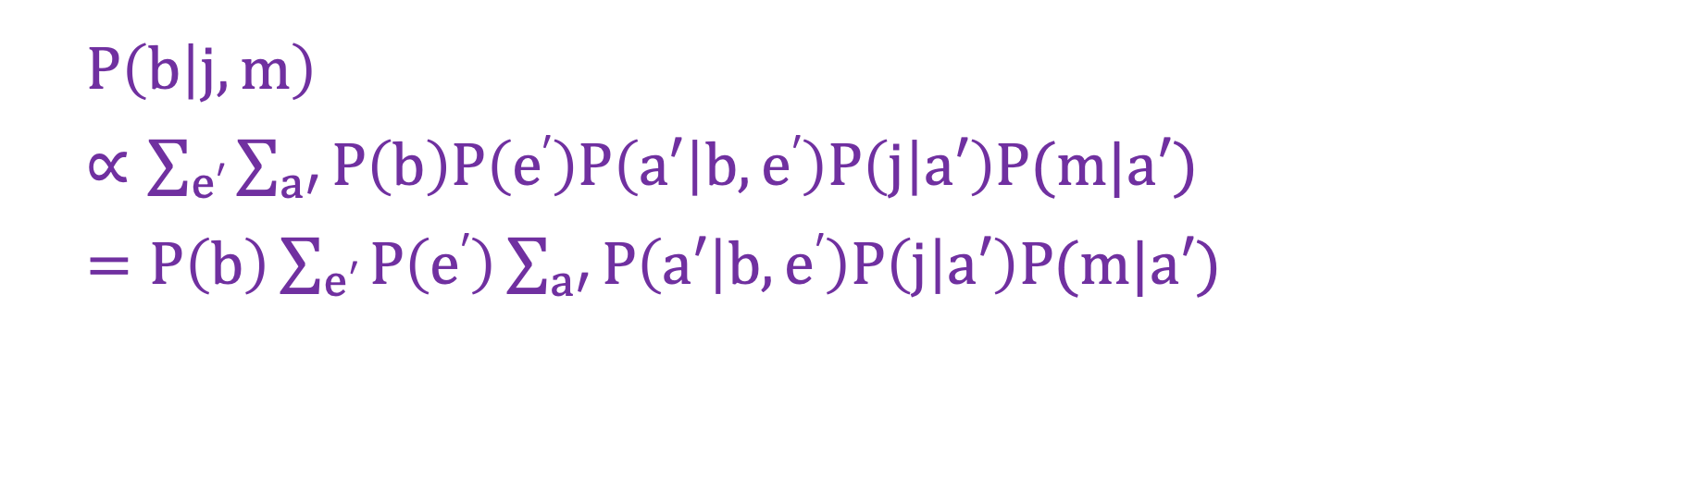
Speed-Up with Pulling Out Terms
B
E
A
M
J
$P\left(b | j,m\right)$
$∝\sum_{e′}{\sum_{a′}{P\left(b\right)P\left(e′\right)P\left(a′ | b,e′\right)P\left(j | a′\right)P(m|a′)}}$
$=P\left(b\right)\sum_{e′}{P\left(e′\right)\sum_{a′}{P\left(a′ | b,e′\right)P\left(j | a′\right)P(m|a′)}}$

Slide 58
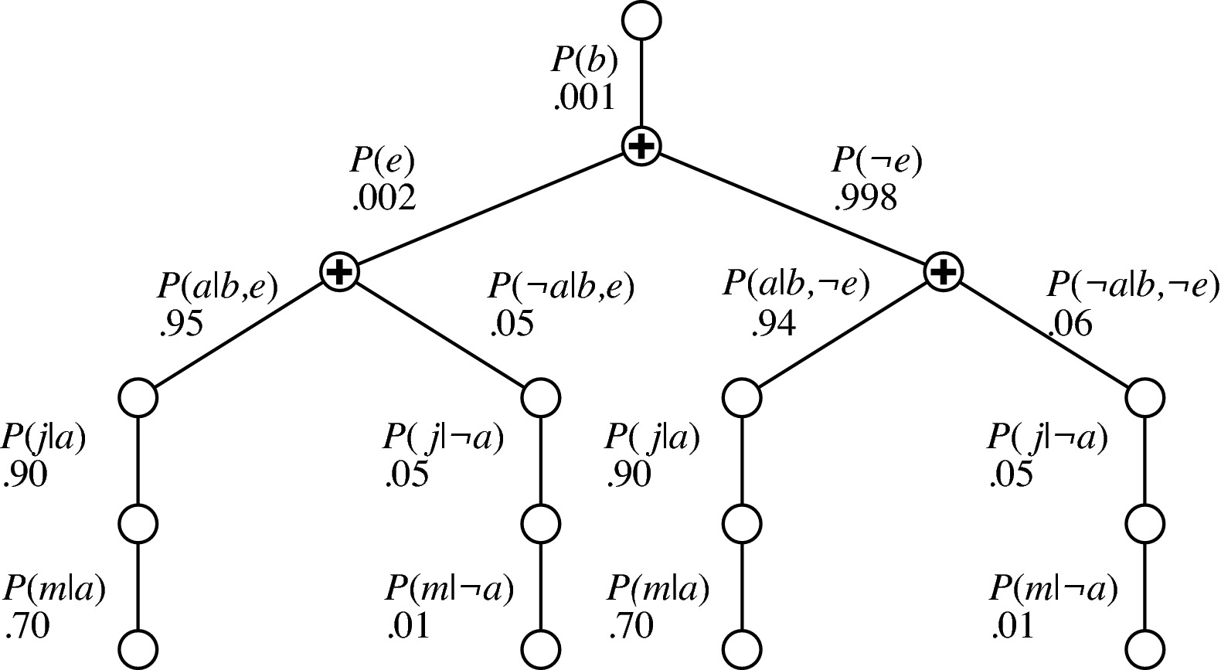
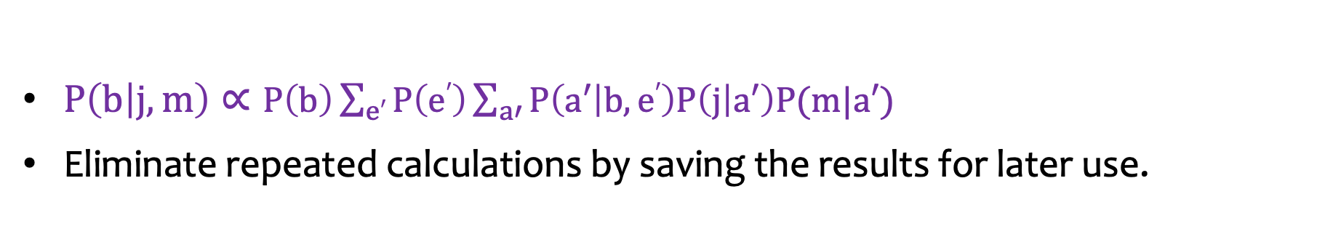
Speed-Up with Variable Elimination
B
E
A
M
J
$P\left(b | j,m\right)∝P\left(b\right)\sum_{e′}{P\left(e′\right)\sum_{a′}{P\left(a′ | b,e′\right)P\left(j | a′\right)P(m|a′)}}$
Eliminate repeated calculations by saving the results for later use.

Slide 59
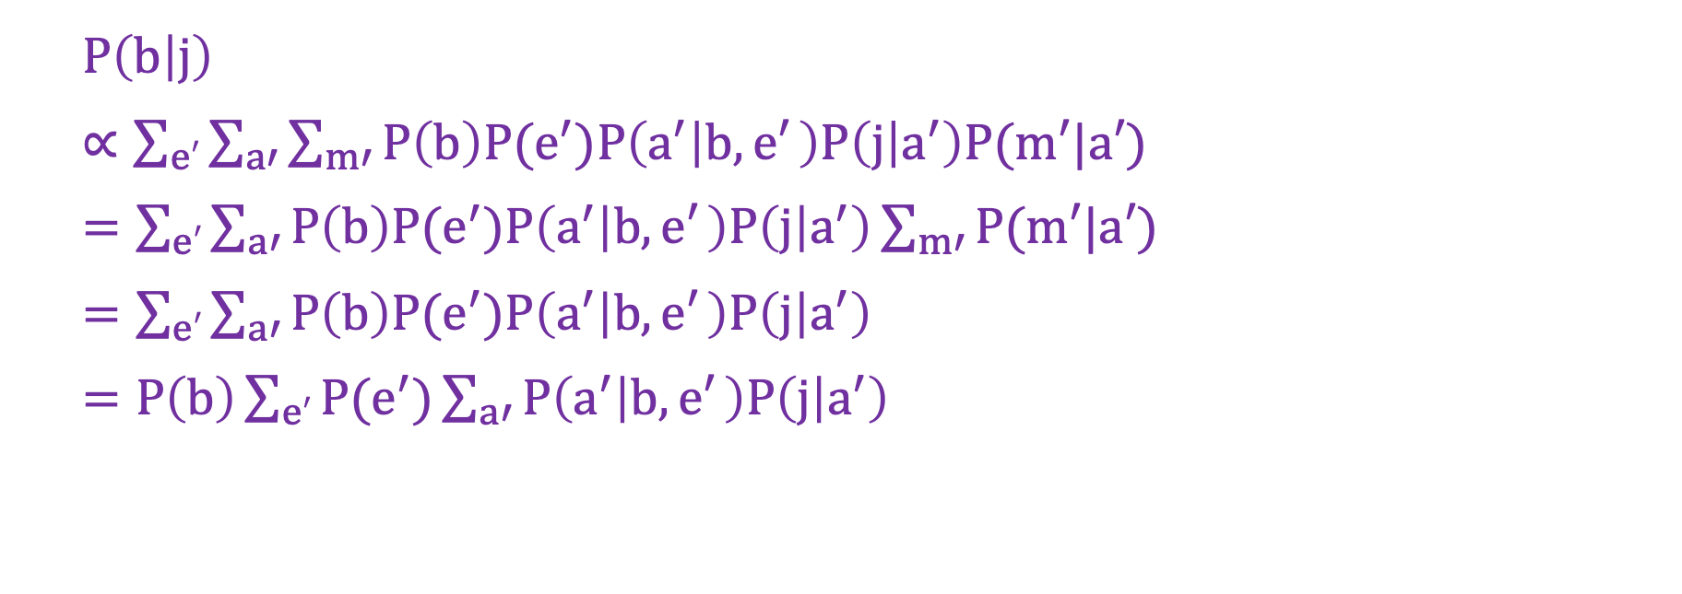
Speed-Up with Independency
B
E
A
M
J
$P\left(b | j\right)$
$∝\sum_{e′}{\sum_{a′}{\sum_{m′}{P\left(b\right)P(e^{′})P\left(a^{′} | b,e′ \right)P\left(j | a^{′}\right)P(m′|a′)}}}$
$=\sum_{e′}{\sum_{a′}{P\left(b\right)P(e^{′})P\left(a^{′} | b,e′ \right)P\left(j | a^{′}\right)\sum_{m′}{P(m′|a′)}}}$
$=\sum_{e′}{\sum_{a′}{P\left(b\right)P(e^{′})P\left(a^{′} | b,e′ \right)P\left(j | a^{′}\right)}}$
$=P\left(b\right)\sum_{e′}{P(e^{′})\sum_{a′}{P\left(a^{′} | b,e′ \right)P\left(j | a^{′}\right)}}$

Slide 60

Recall (Example: 2-Test Cancer)
C
P(c) = 0.01
P(t₁|c) = P(t₂|c) = 0.9
P(t₁|¬c) = P(t₂|¬c) = 0.2
T₁
T₂
P(t₁) = ?
= $\sum_{c′}{\sum_{t_{2}^{′}}{P(c^{′},t1{, t}_{2}^{′})}}$
= $\sum_{c′}{\sum_{t_{2}^{′}}{P({t1|c}^{′})P({t_{2}^{′}|c}^{′})P(c^{′})}}$
= $\sum_{c′}{P({t1|c}^{′})P(c^{′})}$
= P(t₁|c)P(c) + P(t₁|¬c)P(¬c)
= 0.9*0.01 + 0.2*0.99 = 0.207

Slide 61
Outline
Uncertainty
Bayes Rule
Bayesian Networks
D-Separation
Exact Inference (using 3 variable categories: query, hidden, evidence) (and this is assuming we know transition probabilities, which are used for evidence variables)
Approximate Inference: Sampling (to speed up computation even further!) (and still assuming we know the transition variables of evidence variables)

Slide 62
Direct Sampling
B | P(B)
b | 0.001
¬b | 0.999
E | P(B)
e | 0.002
¬e | 0.998
Joint probability distribution table
B
E
B | E | A | P(A|B,E)
b | e | a | 0.95
b | e | ¬a | 0.05
b | ¬e | a | 0.94
b | ¬e | ¬a | 0.06
¬b | e | a | 0.29
¬b | e | ¬a | 0.71
¬b | ¬e | a | 0.001
¬b | ¬e | ¬a | 0.999
A
M
J
A | M | P(M|A)
a | m | 0.7
a | ¬m | 0.3
¬a | m | 0.01
¬a | ¬m | 0.99
A | J | P(J|A)
a | j | 0.9
a | ¬j | 0.1
¬a | j | 0.05
¬a | ¬j | 0.95
P(m)?
¬b, ¬e, ¬a, ¬m
¬b, ¬e, ¬a, ¬m
¬b, e, ¬a, ¬m
¬b, e, ¬a, ¬m
¬b, ¬e, ¬a, ¬m
¬b, ¬ e, ¬a, m
P(m) = Fraction of all sampled events.
Notes:
Idea: generate “random” outputs for relevant nodes (relevant, meaning based on the query: we only generate evidence through sampling for nodes that we need to know to determine the query in order to save time and space) based on (that follow) the known transition probabilities of each node.
For query P(m): we start generating from the top nodes (B and E), and continue to generate “evidence” as we work down the tree, generating evidence (sampling) for every relevant/necessary node’s probability based its distribution except for the query, and then using all of those evidences to then solve using Bayesian network/d-separation
Also, the joint probability table actually also has to do with the fact that conditional (transitional) probability converges (even if we actually have to collect evidence to find out the conditional probabilities convergence before we can use that convergence to make a model as we have done above, generating “random” evidence based on the individual known conditional probabilities (each node has its own probability and/or transitional probability, as shown above).

Slide 63
Direct Sampling (cont’d)
B | P(B)
b | 0.001
¬b | 0.999
E | P(B)
e | 0.002
¬e | 0.998
B
E
B | E | A | P(A|B,E)
b | e | a | 0.95
b | e | ¬a | 0.05
b | ¬e | a | 0.94
b | ¬e | ¬a | 0.06
¬b | e | a | 0.29
¬b | e | ¬a | 0.71
¬b | ¬e | a | 0.001
¬b | ¬e | ¬a | 0.999
A
M
J
A | M | P(M|A)
a | m | 0.7
a | ¬m | 0.3
¬a | m | 0.01
¬a | ¬m | 0.99
A | J | P(J|A)
a | j | 0.9
a | ¬j | 0.1
¬a | j | 0.05
¬a | ¬j | 0.95
P(m|b)?
b, ¬e, a, ¬m
b, ¬e, a, ¬m
b, ¬e, a, m
b, ¬e, a, m
b, ¬e, a, ¬m
b, ¬e, a, ¬m

Slide 64
Hard-to-Sample Cases
B | P(B)
b | 0.001
¬b | 0.999
E | P(B)
e | 0.002
¬e | 0.998
B
E
B | E | A | P(A|B,E)
b | e | a | 0.95
b | e | ¬a | 0.05
b | ¬e | a | 0.94
b | ¬e | ¬a | 0.06
¬b | e | a | 0.29
¬b | e | ¬a | 0.71
¬b | ¬e | a | 0.001
¬b | ¬e | ¬a | 0.999
A
M
J
A | M | P(M|A)
a | m | 0.7
a | ¬m | 0.3
¬a | m | 0.01
¬a | ¬m | 0.99
A | J | P(J|A)
a | j | 0.9
a | ¬j | 0.1
¬a | j | 0.05
¬a | ¬j | 0.95
P(b|a)?

Slide 65
Rejection Sampling
B | P(B)
b | 0.001
¬b | 0.999
E | P(B)
e | 0.002
¬e | 0.998
B
E
B | E | A | P(A|B,E)
b | e | a | 0.95
b | e | ¬a | 0.05
b | ¬e | a | 0.94
b | ¬e | ¬a | 0.06
¬b | e | a | 0.29
¬b | e | ¬a | 0.71
¬b | ¬e | a | 0.001
¬b | ¬e | ¬a | 0.999
A
M
J
A | M | P(M|A)
a | m | 0.7
a | ¬m | 0.3
¬a | m | 0.01
¬a | ¬m | 0.99
A | J | P(J|A)
a | j | 0.9
a | ¬j | 0.1
¬a | j | 0.05
¬a | ¬j | 0.95
P(b|a)?
¬b, ¬e, ¬a
¬b, ¬e, ¬a
b, ¬e, a
¬b, e, ¬a
¬b, ¬e, ¬a
b, ¬e, ¬a
Problem: Reject too many samples! Not efficient!

Slide 66
Likelihood Weighting by Fixing Evidence
B | P(B)
b | 0.001
¬b | 0.999
E | P(B)
e | 0.002
¬e | 0.998
B
E
B | E | A | P(A|B,E)
b | e | a | 0.95
b | e | ¬a | 0.05
b | ¬e | a | 0.94
b | ¬e | ¬a | 0.06
¬b | e | a | 0.29
¬b | e | ¬a | 0.71
¬b | ¬e | a | 0.001
¬b | ¬e | ¬a | 0.999
A
M
J
A | M | P(M|A)
a | m | 0.7
a | ¬m | 0.3
¬a | m | 0.01
¬a | ¬m | 0.99
A | J | P(J|A)
a | j | 0.9
a | ¬j | 0.1
¬a | j | 0.05
¬a | ¬j | 0.95
P(b|a)?
¬b
¬b
b
¬e
¬e
¬e
a
w=0.001
a
w=0.001
a
w=0.94

Slide 67
Likelihood Weighting by Fixing Evidence
B | P(B)
b | 0.001
¬b | 0.999
E | P(B)
e | 0.002
¬e | 0.998
B
E
B | E | A | P(A|B,E)
b | e | a | 0.95
b | e | ¬a | 0.05
b | ¬e | a | 0.94
b | ¬e | ¬a | 0.06
¬b | e | a | 0.29
¬b | e | ¬a | 0.71
¬b | ¬e | a | 0.001
¬b | ¬e | ¬a | 0.999
A
M
J
A | M | P(M|A)
a | m | 0.7
a | ¬m | 0.3
¬a | m | 0.01
¬a | ¬m | 0.99
A | J | P(J|A)
a | j | 0.9
a | ¬j | 0.1
¬a | j | 0.05
¬a | ¬j | 0.95
P(a|b, j)?
b
b
¬e
¬e
In the example, B is fixed evidence, j is generated evidence with a given weight
a
¬a
j
w=0.9
j
w=0.05

Slide 68
Backup

Slide 69
Markov chain Monte Carlo (MCMC) Sampling Algorithms
Rejection sampling and likelihood weighting:
Generating each sample from scratch independently.
MCMC algorithms generate each sample by making a random change to the preceding sample.

Slide 70
Markov Chain for P(A,B|e,m,j)
b
e
¬b
e
a
a
m
j
m
j
b
e
¬b
e
¬a
¬a
m
j
m
j
Wander about for a while, average what you see.

Slide 71
Gibbs Sampling
B
e
It is one of MCMC algorithms.
It generates a next state by randomly sampling a value for one of the nonevidence variables X_{i}.
A
m
j
P(A,B|e,m,j) = ?
Randomly initialize: b, e, j, ¬a, m
Randomly pick B and sample B based on P(B|e,j,¬a,m): ¬b, e, j, ¬a, m
Randomly pick A and sample A based on P(A|¬b,e,j,m): ¬b, e, j, ¬a, m
…

